Slide 1
Chapter Nine: Cultural Regions

Slide 2
Chapter Objective, TEKS, & Essential Questions
Objective:
Understand the distribution, patterns, and characteristics of different cultures and understand how political, economic, and social processes shape cultural patterns and characteristics in various places and regions.
TEKS:
History: 1 (A)
Geography: 5, 5 (A), 9, 9 (A), 9 (B)
Government: 13 (A)
Culture: 16, 16 (A), 16 (B), 17, 17 (A), 17 (D)
Social Studies Skills: 21 (B), 23 (A)
Essential Questions:
How do different cultural regions around the world compare to one another?
Where can you find the main countries and major cities of the world?

Slide 3
Chapter Vocabulary
Cultural Region
Functional Region
Perceptual Region
Middle East
Suez Canal
Latin America
Panama Canal
Sub-Saharan Africa
Oceania

Slide 4
Important Ideas
The characteristics of a place include its cultural, political, economic, and social elements.
A cultural region is a region with people who share common cultural characteristics. Such characteristics include language, political system, religion, foods, customs, and participation in trading networks.
A functional region is an area with a common function, often organized around a key focal point. People may perceive the characteristics of their own and other cultures and regions differently. A perceptual region is a region based on commonly held human attitudes and feelings about an area.
Language, religion, government, land use, education and customs make each cultural region distinctive. Geographers recognize several major cultural regions in the world today, including the Middle East, Latin America, North America, Europe, Russia, Sub-Saharan Africa, China, Japan, South Asia, and Southeast Asia.

Slide 5
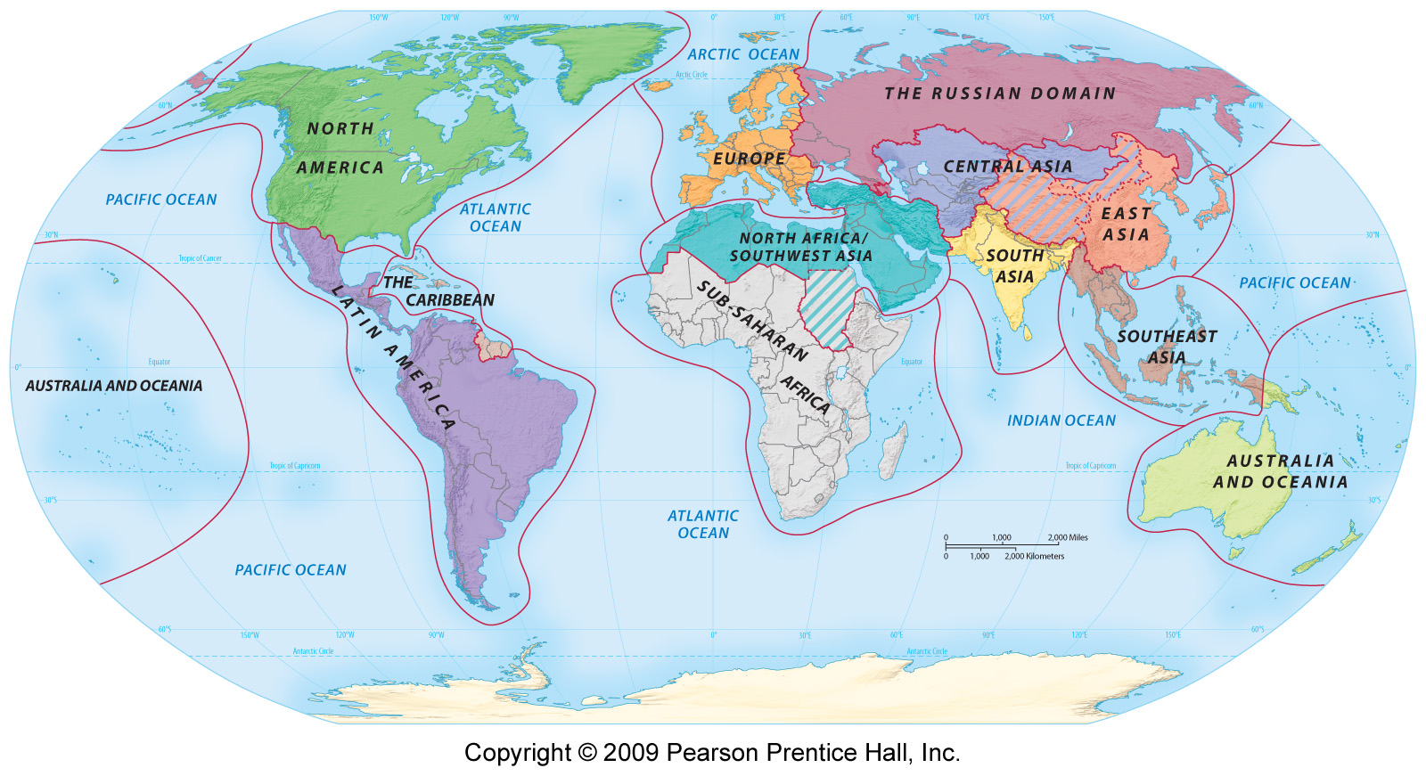
Types of Regions
Geographers define regions in different ways, depending on the type of criteria used to set their boundaries. A region is an area that has common characteristics that distinguish it from neighboring areas.
Formal Region:
A formal region is one with clear boundaries. It is defined by at least one common human or physical characteristic. This may be a common government, such as a political unit.

Slide 6
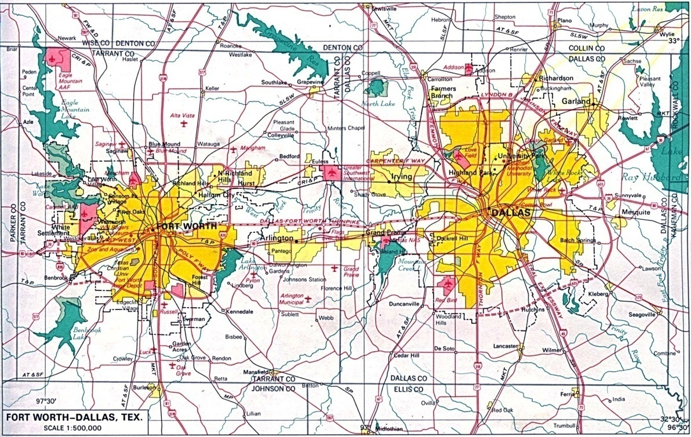
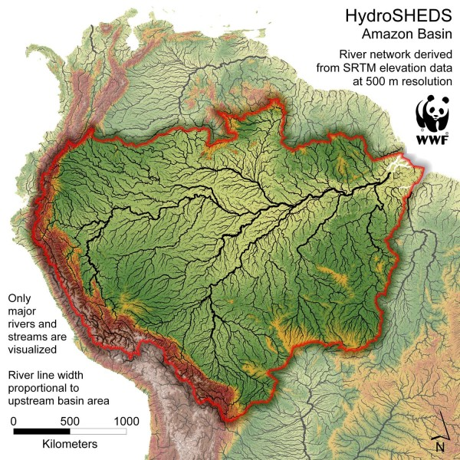
Types of Regions
Functional Region:
A functional region is an area defined by one function that may cross political boundaries. This might be a drainage basin of a great river, connecting several states. Often a functional region is organized around a focal point, such as a city and its metropolitan area.

Slide 7
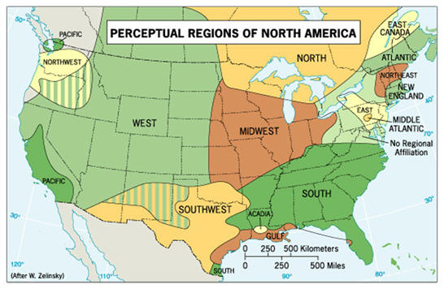
Types of Regions
Perceptual Region:
A perceptual region is based on people's attitudes and emotions about a place, such as the "Deep South," "Dixie," or "The Big Apple" (New York City). Unlike formal or functional regions, a perceptual region may not be based on real facts or conditions. In fact, if you asked people to draw a line around the "Deep South" or the "Midwest“ on a map of the United States, their boundaries might differ.

Slide 8
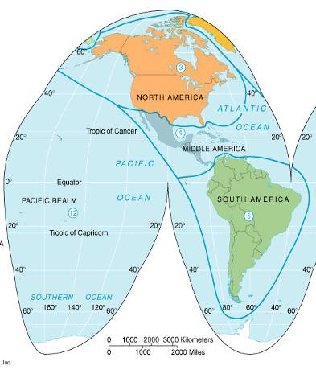
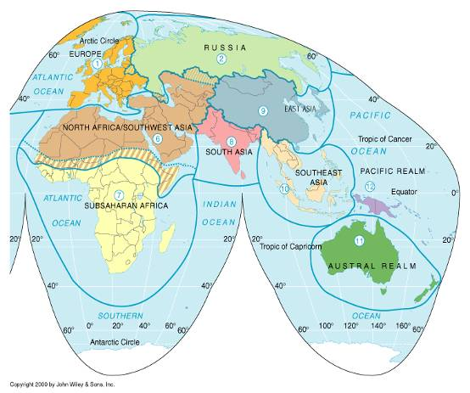
Types of Regions
Cultural Region:
A cultural region is defined by the common characteristics of the people living there. The people in a cultural region may speak the same language, practice the same religion, share the same customs, or live under the same government. They generally have more contacts with each other than with people outside the region.

Slide 9
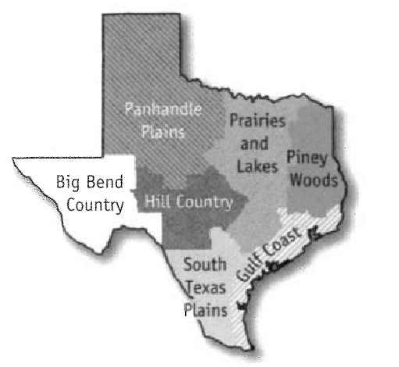
State of Texas
The State of Texas, for example, could be considered as a distinct cultural region. Texans are united by shared historical experiences, by their common state and national government, by their educational system, and by common ways of life. Texans are especially proud of their multicultural heritage, which adds to the diversity and richness of the state.
Even within Texas itself, geographers can identify several regions: the Gulf Coast, South Texas Plains, Piney Woods, Prairies and Lakes, Hill Country, Big Bend Country, and the Panhandle Plains. Each of these regions has its own landscapes and traditions. For example, the Big Bend Country in the southwest is dry, while the Gulf Coast is warm, humid, and densely populated.

Slide 10
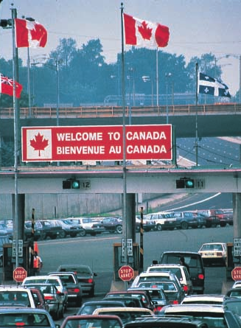
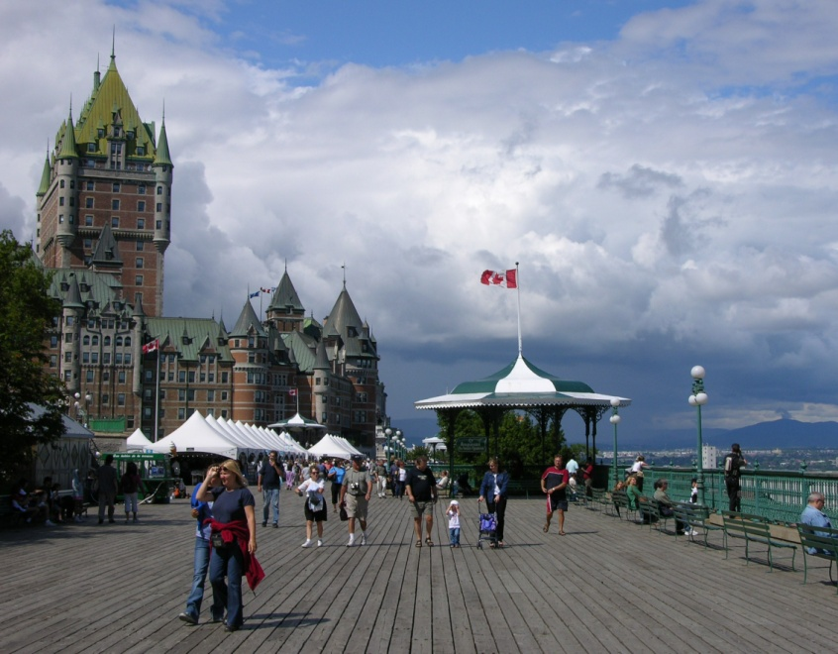
North America
Canada and the United States are often considered as belonging to the same cultural region. The majority language in both countries is English. Both countries were once British colonies. The majority of people in both countries follow the Christian religion. Both were once home to Native American Indians and had sparsely settled spaces in the West, which were gradually settled by pioneers. Both countries have democratically elected governments. Citizens in both countries follow similar occupations and enjoy similar ways of life.

Slide 11
North America
Major Countries: | Canada and the United States
Major Cities: | Montreal, Toronto, Quebec, Vancouver, New York City, Los Angeles, Dallas, Washington D.C., Chicago, Philadelphia, Miami
Physical Features: | Rocky Mountains, Canadian Shield, Great Plains, Hudson Bay, Mississippi River
Regions: | Each State /Province (Formal), Mississippi River Basin (Functional), Deep South (Perceptual)
Major Language(s): | English and French
Major Government(s): | Democratic
Major Religion(s): | Christianity
Culture / Customs:
Economics / Trade: | World Trading Partners, U.S. World’s Largest Importer

Slide 12
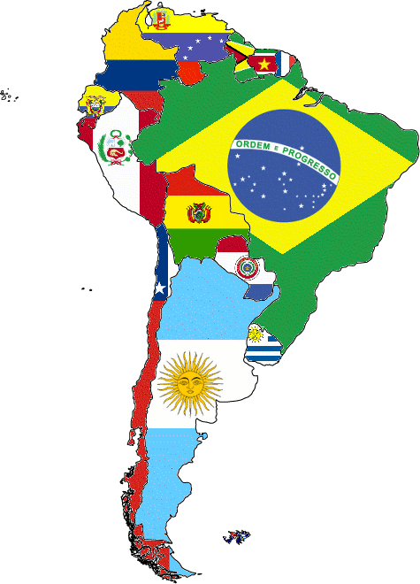
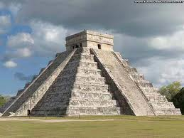
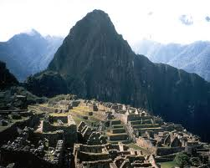
Latin America
The name "Latin America" is applied to all of the Americas south of the United States. This region is called "Latin America" because it was once colonized by Spain and Portugal, whose languages come from Latin. European conquerors failed to recognize Native American ownership of their land, since they saw "Indians" as non-Christian and uncivilized.

Slide 13
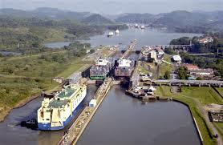
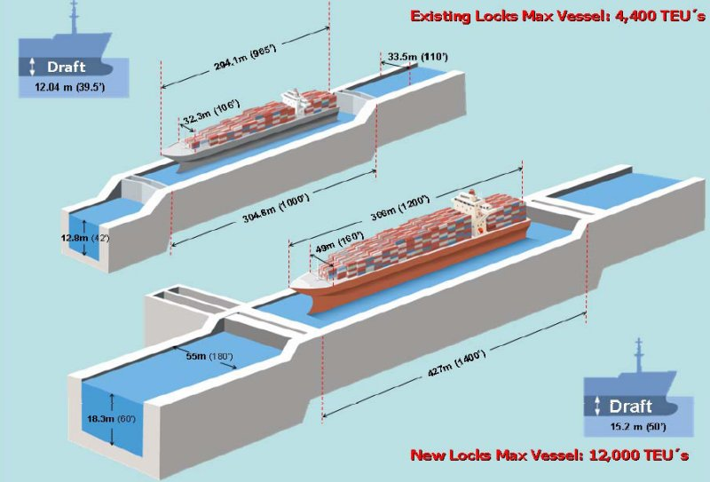
Latin America
Many Latin Americans today are of mixed Native American Indian and European descent. Most speak Spanish or Portuguese and follow the Catholic religion. People in this region share a common history and many traditions.

Slide 14
Latin America
Major Countries: | Mexico, Brazil, Argentina, Chile, Peru, Venezuela, and Cuba
Major Cities: | Mexico City, Rio de Janeiro, Buenos Aries, Lima, Santiago
Physical Features: | Andes Mountains, Amazon River, Amazon Rainforest, Pampas, Caribbean Sea, Sierra Madres, Panama Canal
Regions: | Any Country (Formal), Amazon River Basin (Functional), Panama Canal (Functional)
Major Language(s): | Spanish and Portuguese
Major Government(s): | Democratic, Some Dictatorships
Major Religion(s): | Christianity (Roman Catholic)
Culture / Customs:
Economics / Trade: | Panama Canal (Vital Trade Route), Manufacturing Industries

Slide 15
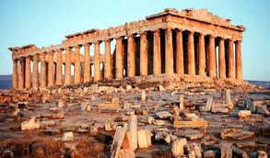
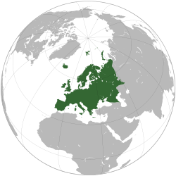
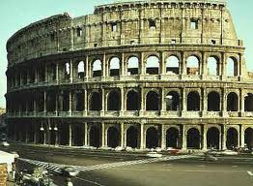
Europe
Europe and Asia share the same land mass, which is so large that geographers have divided it into two continents. Europe's location, close to Africa and the Middle East, enabled Europeans to borrow heavily from the cultures of both of these regions.
The Greeks were the first Europeans to develop their own civilization. Their culture has had a lasting impact on Western civilization. It set standards against which later peoples measured themselves. Much of Europe was later united by the Romans

Slide 16
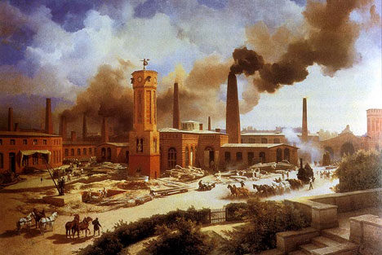
Europe
After the fall of the Roman Empire, Europe became divided into a series of warring kingdoms with their own languages and cultures. Nevertheless, Europeans remained united by the Christian religion. In the late 1400s, Europeans again became leaders in technology and culture during the Renaissance. Europe remained the most powerful and technologically advanced region of the world for the next 500 years. It was further propelled by the French and Industrial Revolutions. European nations colonized vast regions around the world and spread their technology and many aspects of their way of life.

Slide 17
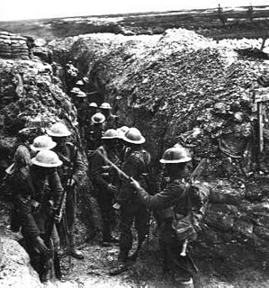
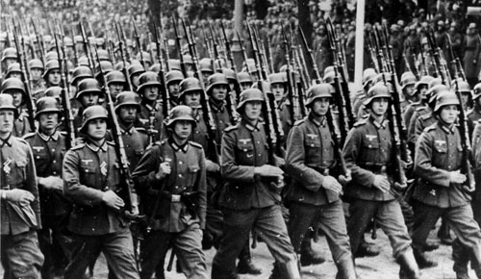
Europe
Europeans then fought two major world wars, resulting in unprecedented death and destruction. World War II stimulated the desire for independence in the colonies of Africa and Asia. European colonial powers had spent their energies fighting in World War II and could not resist these independence movements. Today, Europe consists of a number of nations. Most of them are now united in the European Union.

Slide 18
Europe
Major Countries: | Great Britain, France, Germany, Belgium, Austria, Spain, Portugal, Italy, Ireland, Norway, Denmark, Sweden, and Poland
Major Cities: | London, Madrid, Paris, Copenhagen, Rome, and Berlin
Physical Features: | Alps, English Channel, Thames River, Rhine River, Mediterranean Sea,
Regions: | European Union (Formal), Mediterranean Sea (Functional), English Channel (Functional), Eastern Europe (Perceptual)
Major Language(s): | English, Spanish, Italian, French, German
Major Government(s): | Democratic
Major Religion(s): | Christianity
Culture / Customs:
Economics / Trade: | Major World Trading Partners, European Union Trade Organization, Service Industries

Slide 19
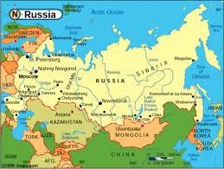
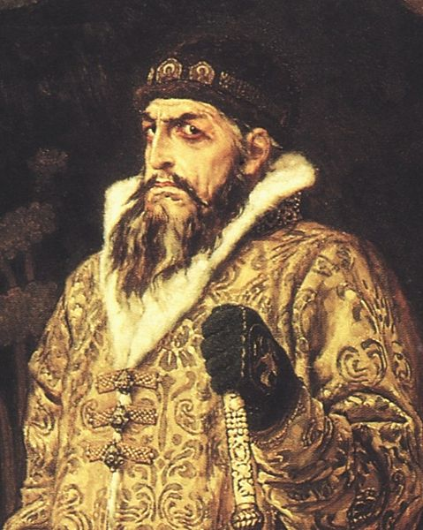
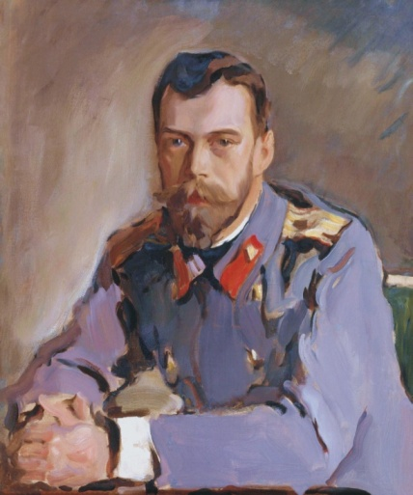
Commonwealth of Independent States
Russia was separated from the rest of Europe for much of its history. Russia's rulers adopted Eastern Orthodox Christianity from Constantinople. Russia was later conquered by the Mongols of Asia. A new ruler, known as the Tsar, later emerged with absolute power. Originally, Russia was a small state centered in Moscow. In the 18th century, Russia's tsars introduced Western European ways. Russia then set about conquering neighboring territories, greatly expanding its size. Meanwhile, the bulk of Russia's vast peasant population continued to live in great poverty.

Slide 20
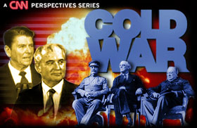
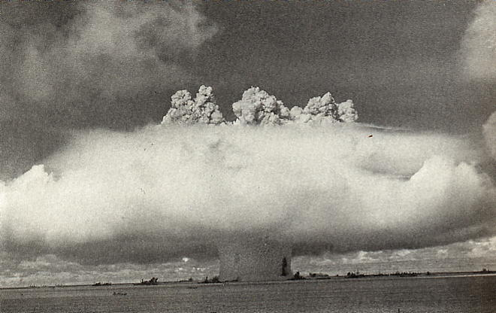
Commonwealth of Independent States
During World War I, the Tsar's government collapsed. Soon after, Russia became the world's first Communist country- known as the Soviet Union. The Soviet Union and other nearby Communist states developed their own distinct culture based on state-ownership, Communist ideals, and totalitarian government. In 1991, after nearly 80 years as a Communist dictatorship, the Soviet Union dissolved into Russia and several smaller states. These remain loosely associated as the Commonwealth of Independent States.

Slide 21
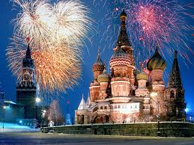
Commonwealth of Independent States
These states share a common history, often speak several related languages, and have common ethnic minorities.
Foreign invaders have sometimes failed to conquer Russia because of its vast interior and cold winters. Napoleon lost half a million soldiers to the bitter cold temperatures in 1812. In 1941, Hitler invaded the Soviet Union. German tanks became bogged down in the mud, and their equipment and soldiers later froze. Millions of Soviets still died in the war.

Slide 22
Commonwealth of Independent States
Major Countries: | Russia, Ukraine, Kazakhstan
Major Cities: | Moscow, St. Petersburg, Kiev
Physical Features: | Ural Mountains, Siberia, Ob River, Volga River, Black Sea, Caspian Sea, Lake Baikal
Regions: | C.I.S. (Formal), Former Soviet Union (Formal), Trans-Siberian Railway (Functional), Siberia (Perceptual)
Major Language(s): | Russian, Slavic, Ukrainian
Major Government(s): | Democratic, Some Dictatorships
Major Religion(s): | Christianity (Eastern Orthodox)
Culture / Customs:
Economics / Trade: | Resource Industries (Oil, Gas, Coal), C.I.S. Trade Organization, Russia Major Trading Partner of Area

Slide 23
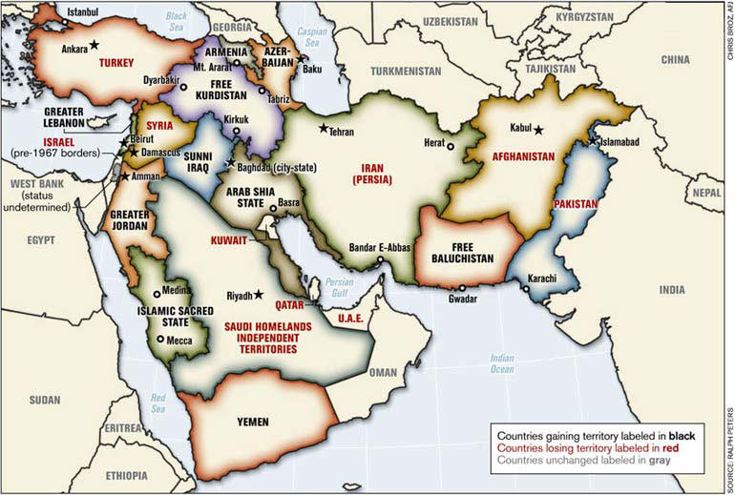
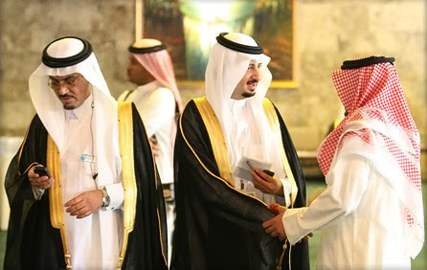
Middle East & North Africa
The Middle East is the crossroads of three continents - Africa, Asia and Europe. In fact, it is where human civilization first developed. A large number of people in the Middle East today have a common history and heritage. The vast majority of these people are Muslims. Most speak Arabic. At one time, almost all of this region was ruled by the Ottoman Empire. Finally, the peoples of the Middle East communicate and trade more with each other than with peoples outside the region.

Slide 24
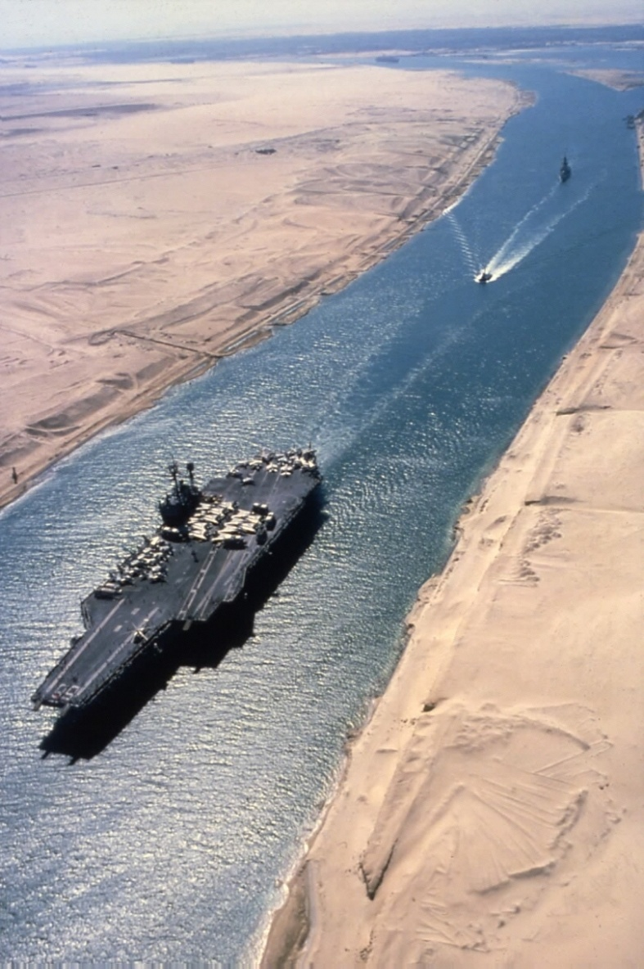
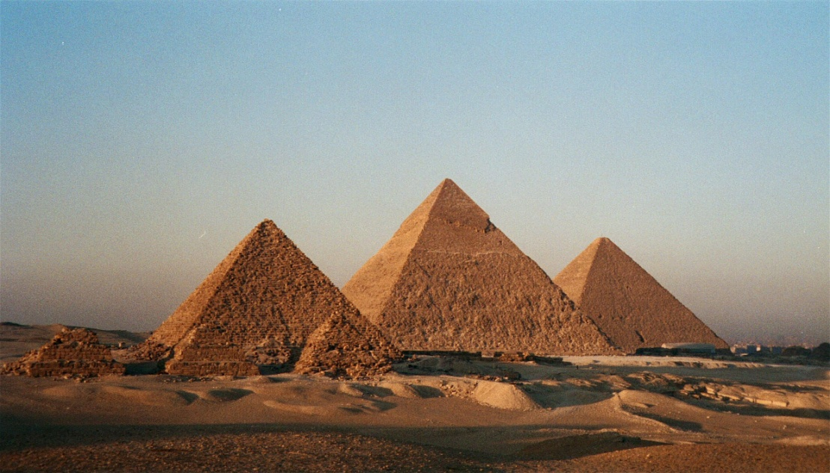
Middle East & North Africa
The region of North Africa is found north of the Sahara Desert. In this region, ancient Egypt once gave rise to one of the world's first civilizations. Because contacts between African peoples were limited by geographical barriers, each people or tribe developed its own culture, language, and traditions. North Africa was then colonized by Britain, France, and Italy. Today, the peoples of North Africa are mainly of Arab descent and the dominant religion is Islam. Because of these factors, this region is often considered to be closely tied to the Middle East.

Slide 25
Middle East & North Africa
Major Countries: | Turkey, Iran, Iraq, Saudi Arabia, Israel, Syria, Algeria, Egypt, Libya, Morocco, and Ethiopia
Major Cities: | Cairo, Alexandria, Addis Abba, Jerusalem, Baghdad, Mecca, Tehran
Physical Features: | Sahara Desert, Nile River, Arabian Desert, Tigris and Euphrates River, Persian Gulf, Suez Canal
Regions: | Any Country (Formal), Nile River Delta (Functional), Suez Canal (Functional), Holy Land (Perceptual)
Major Language(s): | Arabic, English, Persian (Farsi), Hebrew
Major Government(s): | Democratic, Monarchy, Theocracy, Dictatorships
Major Religion(s): | Islam, Judaism
Culture / Customs:
Economics / Trade: | Major Oil Trading Partner, Many O.P.E.C. Nations, Suez Canal and Persian Gulf Vital Trade Routes

Slide 26
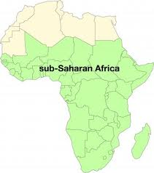
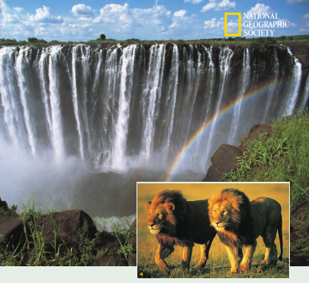
Sub-Saharan Africa
The area of Africa south of the Sahara Desert, with its different climate, topography, and non-Arab populations, is seen as forming a separate and distinct cultural region. Most of this region has a warm climate.

Slide 27
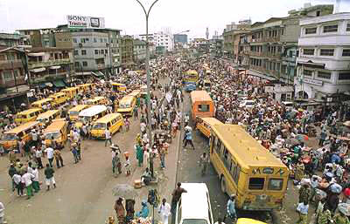
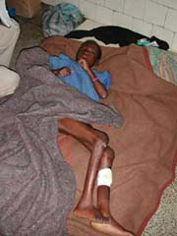
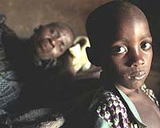
Sub-Saharan Africa
Many people in this region were once subject to the slave trade or European colonial rule. People remain divided into a large number of separate ethnic groups, or tribes, each with its own language and culture. They often share similar religious beliefs. Africans have been influenced by both Islam and Christianity, as well as by local animist traditions.

Slide 28
Sub-Saharan Africa
Major Countries: | Nigeria, Kenya, Uganda, and South Africa
Major Cities: | Nairobi, Lagos, Cape Town
Physical Features: | Savanna, Rainforest, Kalahari Desert, Congo River, Lake Victoria,
Regions: | Any Country (Formal), Congo River Basin (Functional), Gold Coast (Functional/Perceptual), Ivory Coast (Functional/Perceptual)
Major Language(s): | English, French, Belgian, Many Tribal Languages
Major Government(s): | Democratic, Dictatorships
Major Religion(s): | Islam, Christianity, Animism
Culture / Customs:
Economics / Trade: | Resource Industries (Gold, Diamond), Black Market (Ivory, Exotic Animals, Poaching),

Slide 29
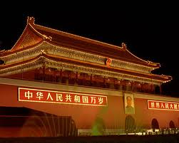
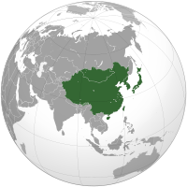
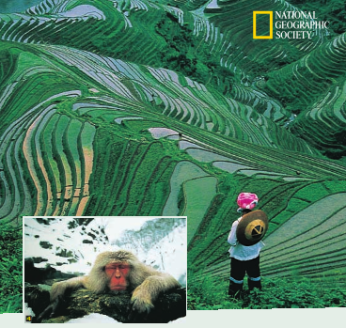
East Asia
China has been the world's most populous country for most of its history. Today, one of every five people in the world is Chinese. For thousands of years, China was ruled by all-powerful emperors. Different groups of Chinese spoke different dialects, but they were all united by a common system of writing, based on characters. They also shared distinctive religious beliefs- Confucianism, Taoism, and Buddhism.

Slide 30
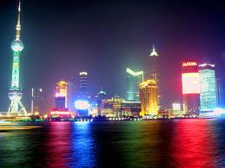
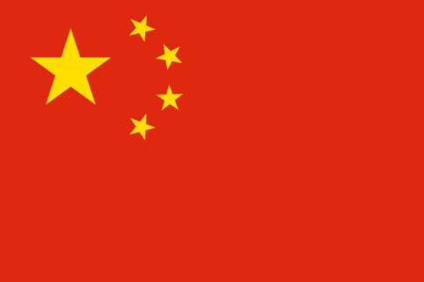
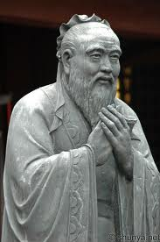
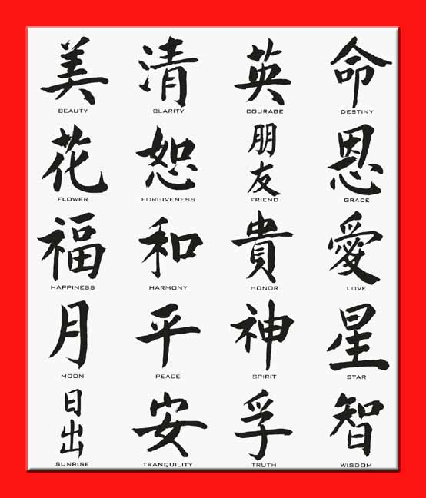
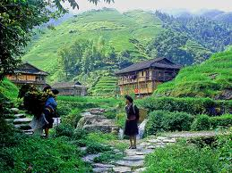
East Asia
The largest concentration of people in China live on the fertile lands in the east and along China's vast coastline. Since opening its economy to foreign investments, China has undergone an economic revolution. Its educated, low-wage labor force has helped to propel China forward, making it the world's fastest-growing economy.

Slide 31
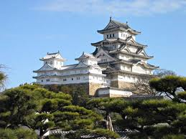
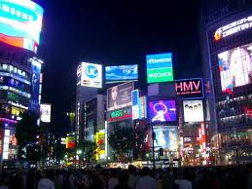
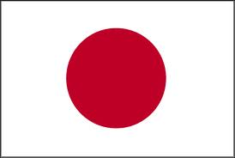
East Asia
Japan consists of four main islands and thousands of smaller ones. Although ancient Japan was greatly influenced by China, it developed its own language, system of writing, religious beliefs, and customs. It was the first Asian nation to borrow Western ways and to industrialize. Although 85% of Japan's land is covered by mountains, it has a relatively large population. Its high population density has led to a social closeness and promoted the ability of its people to work together. Japan lacks many natural resources necessary for modem industry and must import much of what it needs.

Slide 32
East Asia
Major Countries: | China, Mongolia, North Korea, South Korea, and Japan
Major Cities: | Beijing, Shanghai, Hong Kong, Seoul, Tokyo, Osaka, Kyoto, and Hiroshima
Physical Features: | Himalayan Mountains, Gobi Desert, Huang He River, Mt. Fuji, Tibetan Plateau
Regions: | Demilitarized Zone [DMZ] (Formal/Functional), Ring of Fire (Perceptual)
Major Language(s): | Mandarin Chinese, Korean, Japanese
Major Government(s): | Democratic, Totalitarianism
Major Religion(s): | Buddhism, Christianity, Shinto
Culture / Customs:
Economics / Trade: | Major Trading Partner of the World, China World’s Largest Exporter, Japan Imports Because It Lacks Natural Resources

Slide 33
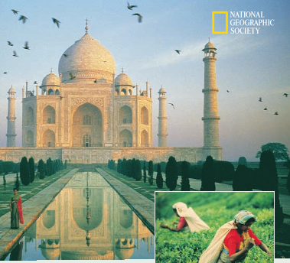
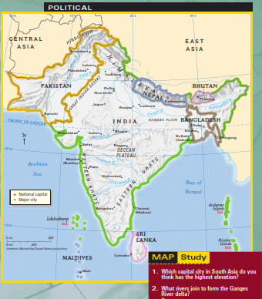
South Asia
This Himalayan Mountains have allowed peoples on both sides of the mountains to develop their own separate languages, customs, and cultures. The main rivers of the Indian subcontinent, the Indus and Ganges, were the sites of some of the world's earliest civilizations. In ancient times, Aryan invaders conquered the subcontinent and introduced the Hindu religion and caste system.

Slide 34
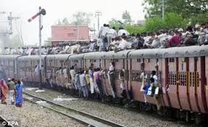
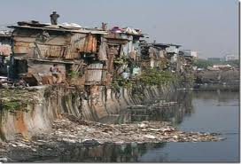
South Asia
The subcontinent's nearness to the Middle East next led to the spread of Islam into the region. In the 1700s, much of India fell under British rule. When India later became independent in 1947, it separated into Hindu India and Muslim Pakistan. Former East Pakistan later became Bangladesh. Today, India is the world's second most populous country. Most Indians are Hindus. Indians speak English as well as Hindi and other local languages. To the north, mountainous Afghanistan separates this region from the Middle East.

Slide 35
South Asia
Major Countries: | India, Bangladesh, Nepal, Pakistan, Bhutan, and Afghanistan
Major Cities: | Kabul, Islamabad, Mumbai, Delhi, Calcutta, and Madras
Physical Features: | Himalayan Mountains, Ganges River, Indus River, Monsoons
Regions: | Any Country (Formal), Indus River Valley (Functional), Ganges River Delta (Functional), Kashmir (Perceptual),
Major Language(s): | English, Hindi, Arabic
Major Government(s): | Mainly Democratic
Major Religion(s): | Islam, Hinduism, Sikhism, Buddhism
Culture / Customs:
Economics / Trade: | World Trading Partner for Manufacturing and Offshoring Services

Slide 36
Southeast Asia
Southeast Asia has been heavily affected by the large mix of peoples coming into this region, especially Chinese, Indians, Arabs, and European colonial powers.

Slide 37
Southeast Asia
The islands of Southeast Asia, once known as the East Indies, export important spices such as pepper, cinnamon, and nutmeg, used in cooking all over the world. In earlier times, these spices were highly prized in Europe and the Middle East because they provided a way of preserving food that was more flavorful than using only salt. Arab traders brought Islam to the region, where it spread rapidly. Although much of the region continues to follow traditional ways of life, the growth of cities, improvements in technology, and government programs aimed at modernization are making inroads into traditional village life.

Slide 38
Southeast Asia
Major Countries: | Indonesia, Thailand, Vietnam, Malaysia, and the Philippines
Major Cities: | Bangkok, Jakarta, Singapore, Hanoi, Taipei, and Manila
Physical Features: | Pacific Ocean, Indian Ocean, Indochina Peninsula, Mekong River, Rainforests
Regions: | Any Country (Formal), Port of Singapore (Functional), Indochina (Perceptual)
Major Language(s): | English, Vietnamese
Major Government(s): | Democratic, Some Dictatorships
Major Religion(s): | Buddhism, Islam, Christianity
Culture / Customs:
Economics / Trade: | Vital Trading Route of the Region, Spice Trade Throughout History

Slide 39
Australia & Oceania
Australia is the only country to occupy an entire continent. Located in the Pacific Ocean, it is home to its own aboriginal peoples. British settlers established a colony in 1788. Today, the desert-like interior of Australia is sparsely populated. Its south and east coasts boast large cities and a prosperous way of life similar to that of Europe and the United States.

Slide 40
Australia & Oceania
New Zealand, also colonized by the British, and other smaller island nations, such as Tahiti, are spread across the South Pacific. Geographers refer to these Pacific islands as Oceania.

Slide 41
Australia & Oceania
Major Countries: | Australia, New Zealand, Tahiti, Marshall Islands, Guam
Major Cities: | Melbourne, Sydney, Auckland
Physical Features: | Great Barrier Reef, Great Sandy Desert, Pacific Ocean
Regions: | Any Country (Formal), Great Barrier Reef (Functional), Outback (Perceptual), Oceania (Perceptual)
Major Language(s): | English, Polynesian, Many Tribal Languages
Major Government(s): | Democratic
Major Religion(s): | Christianity, Animism
Culture / Customs:
Economics / Trade: | Australia is a World Trading Partner with Service Industries, Islands of Oceania Have Mainly Traditional Economies

